Slide 1

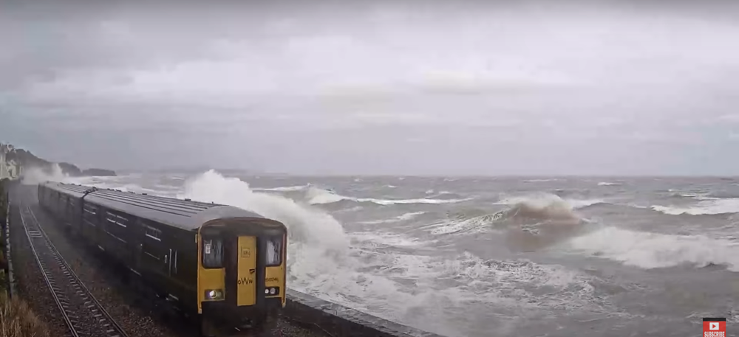

Webcams
by the Sea

Slide 2
The Team
Jenny Brown
Hannah Brown
Rob McEwan
Vahid Seydi
James Murphy
Lucy Harris
Jamie Young
Shannon Leakey
Andy Matthews
Richard Renshaw

Slide 3
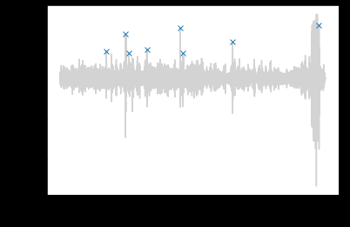
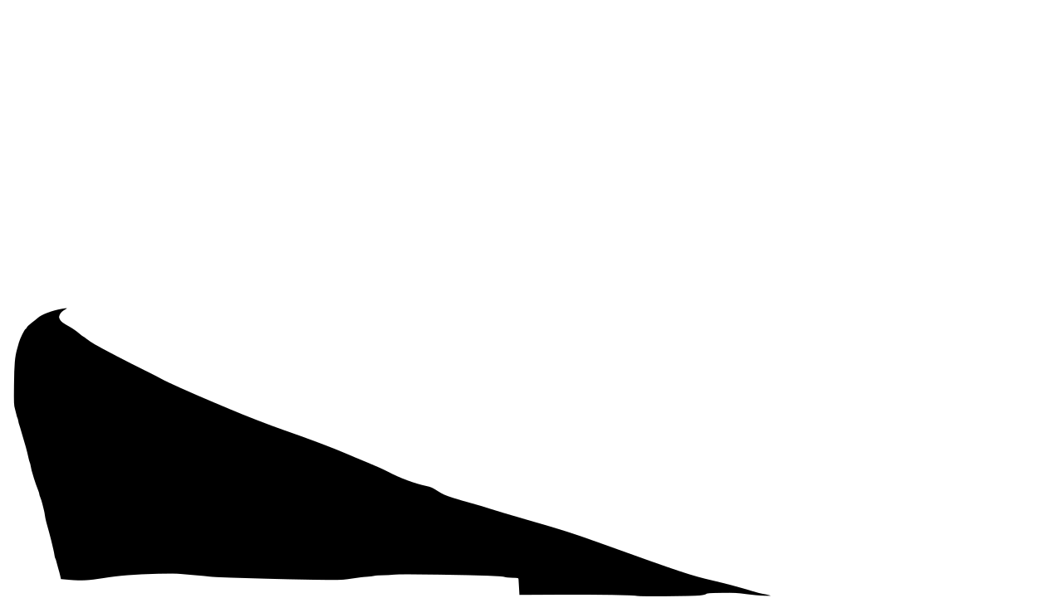
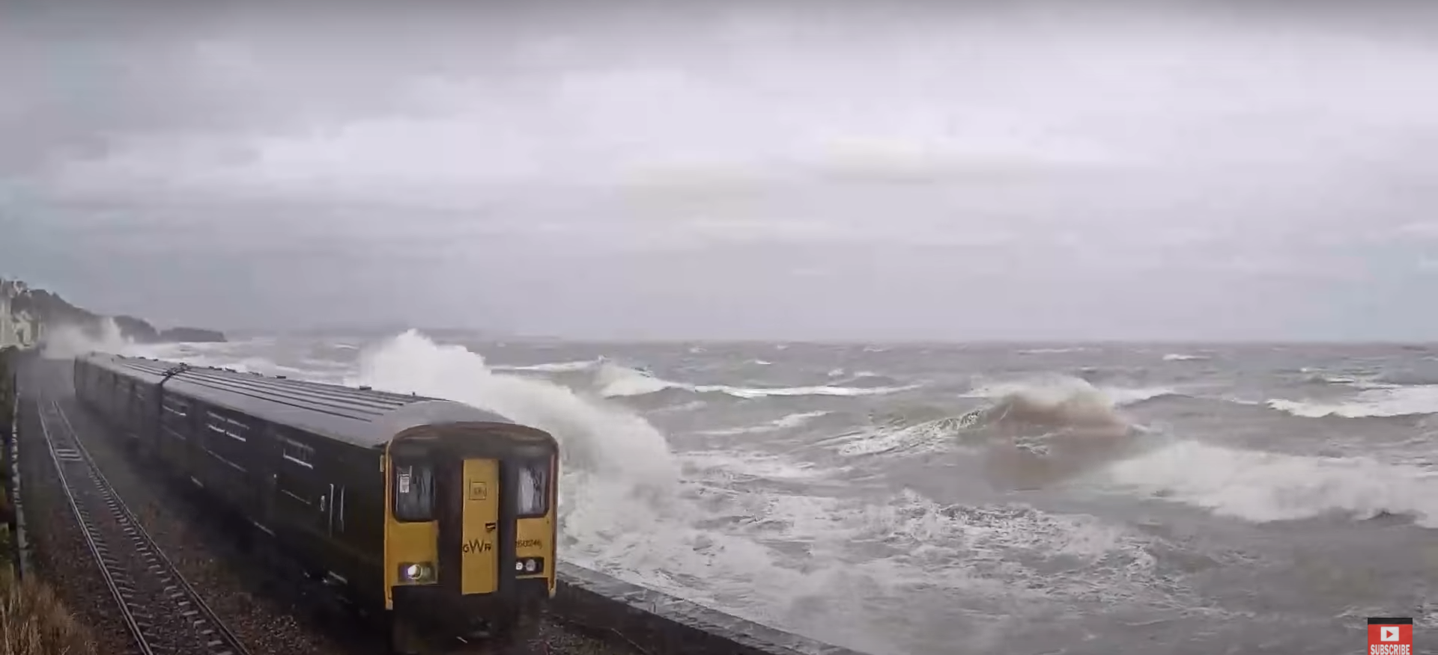
Non-machine learning techniques
Audio analysis
Visual threshold check
+ web interface, stats

Slide 4
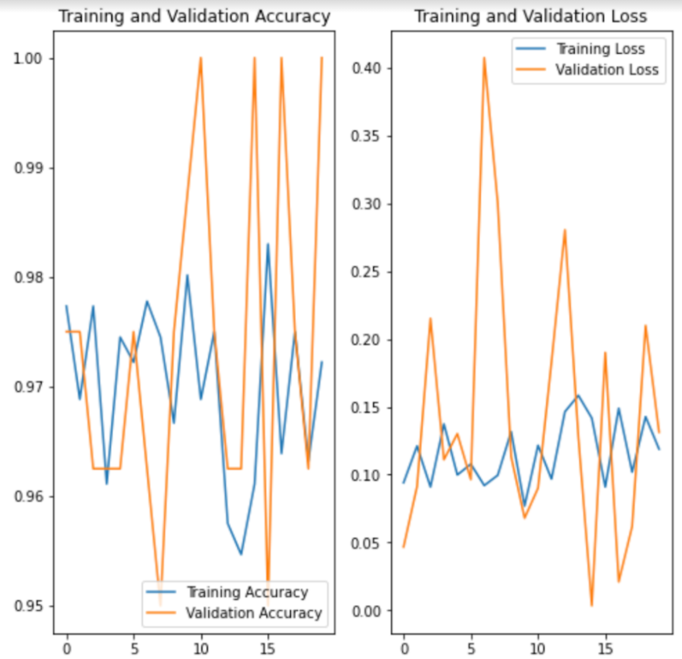
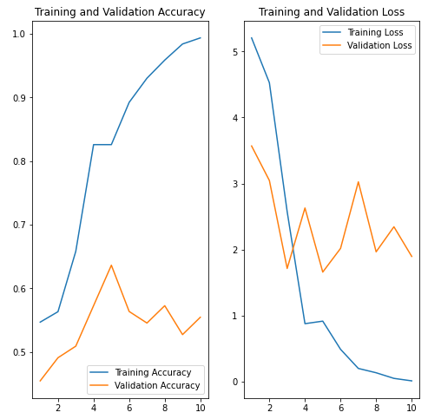
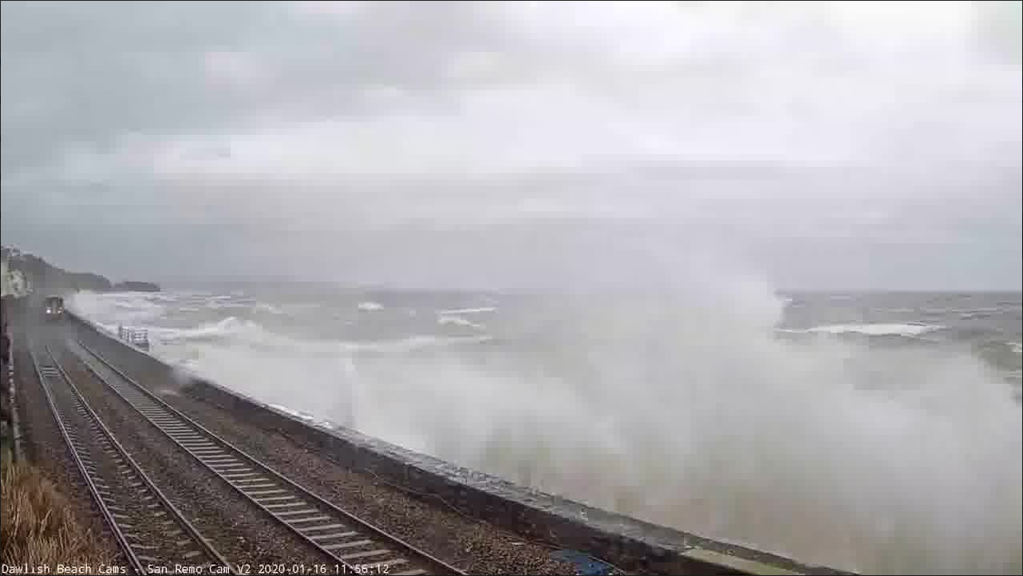
A machine learning solution
Aim: To make use of machine learning (namely convolutional neural network) to identify instances of overtopping on seawall in Dawlish.
Images pulled from webcams fitted in Dawlish
Ran a comparison of a transfer learning approach and training a CNN on data available (ideally would have a much larger set of images to train on)
When given an image, the model will return a probability of overtopping being present in the image.

Slide 5
Link to climate resilience
Apply the model to live streamed webcam footage and build up an archive of overtopping events. Over time this would increase understanding of frequency and length of these events and whether they are likely to increase as a result of climate change.
The output could also be combined with both weather forecasting and climate projection data to better understand the risks of climate change to coastal infrastructure.

